Slide 1
Installation Guide
(JDK – JEE 1.4 SDK)
2008. 12. 11
CODELABOR
Shin Sang Jae (codelabor@gmail.com)

Slide 2
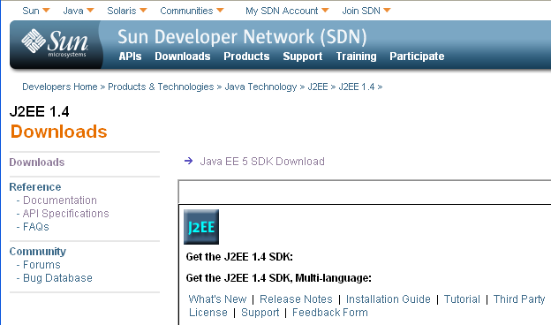
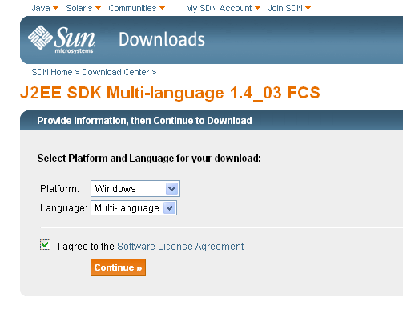
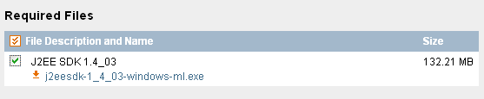
JDK
Installation
Official Site URL: http://java.sun.com
Download Site URL: http://java.sun.com/j2ee/1.4/download.html
File: j2eesdk-1_4_03-windows.exe

Slide 3

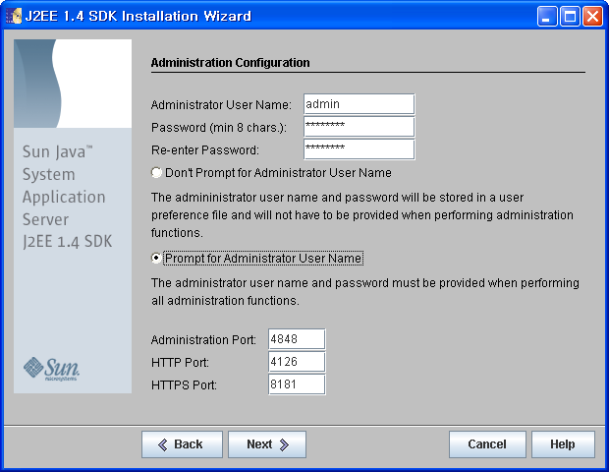
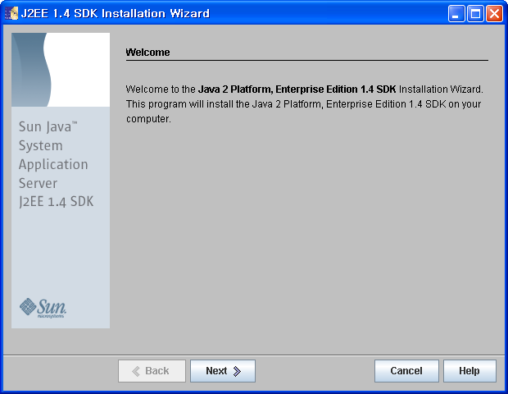
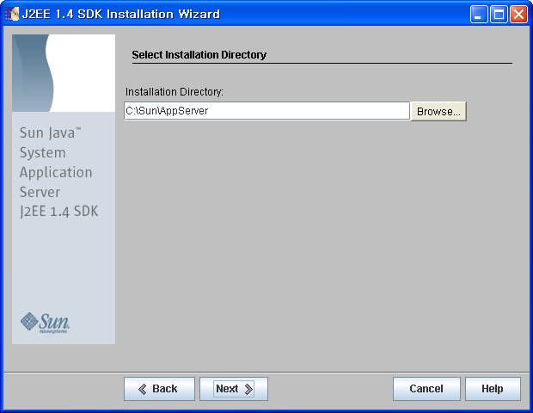
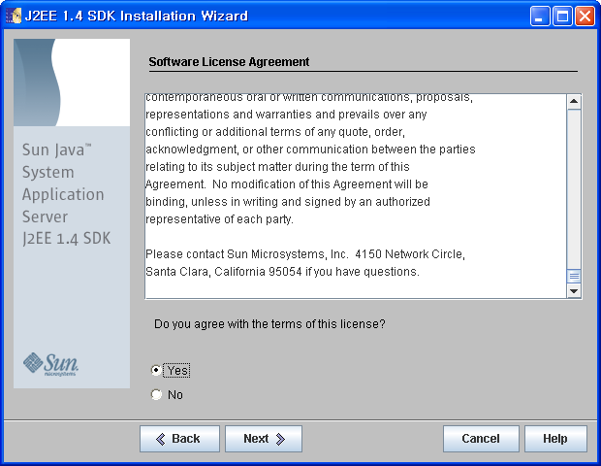
JDK
Installation
Directory: C:\Sun\AppServer

Slide 4
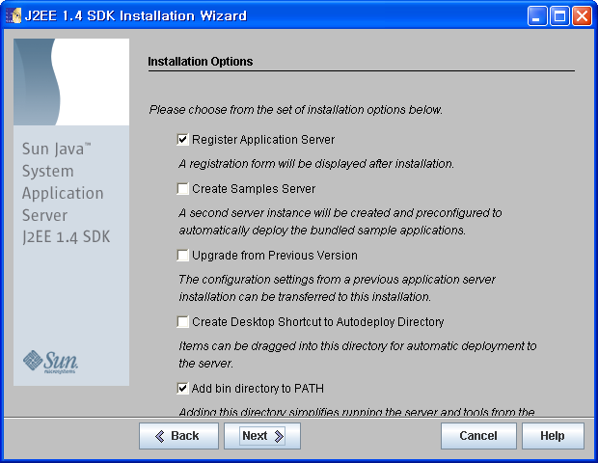
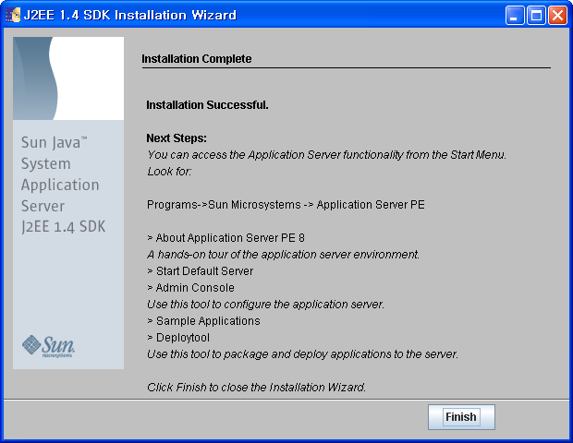
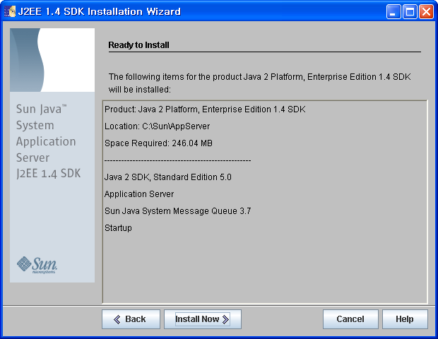
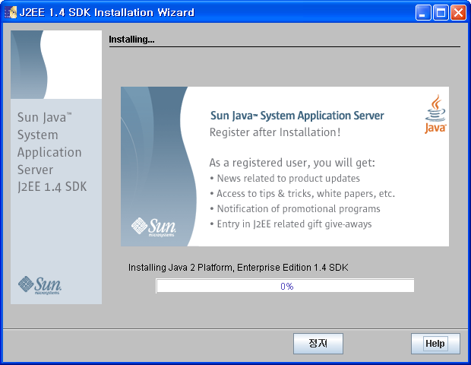
JDK
Installation

